Slide 1
Pokemon Data Analysis
(Scarlet/Violet)
Rishi Rana

Slide 2
Purpose
Provide data analysis on the pokemon from Paldea Region (Scarlet/Violet).
Displays stats for pokemon, including their base stats, types, catch rates, and egg cycles.
Goal is to analyze these values to find insights that can help players enhance their gameplay.

Slide 3
Analysis Questions
1. What are the top 5 Pokémon with the highest total base stats?
2. What are the most common Pokémon in Scarlet/Violet based on catch rate?
3. What are the least common Pokémon based on catch rate?
4. Which Pokémon have the lowest egg cycles in this Paldea?

Slide 4
Who are the Beneficiaries
Players
  For more early game players, they can use the low egg cycles of the pokemon for breeding mechanics and speed up a lot of early game progression|
  Also using the base statistics, you can create a decently high valued team to help in either the competitive scene or just throughout progression

Slide 5
Methodology
I used the pokemonDB database
Scraped all pokemon from the paldea region
Transformed everything into a dataframe
Using the dataframes, I created graphs and answered the analysis questions

Slide 6
Tools Used
Python – The primary coding language
Requests – Scraping the date off web pages and collect HTML
BeautifulSoup – Parsing and navigating HTML
Pandas – Organizing data into Data Frames and preforming statistical analysis
Matplotlib – Creating visuals (bar graphs) to help show trends and insights
Seaborn – Create a more user-friendly graph that is more appeasing to viewers

Slide 7
Sample Analysis
Unit of Analysis: Each Pokemon
  Name of Pokemon
  Types
  Total Base Stat
  Catch Rate
  Egg Cycles

Slide 8
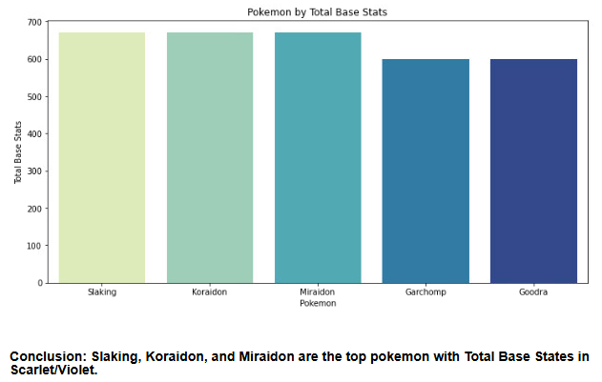
Results: 1. What are the top 5 Pokémon with the highest total base stats?

Slide 9
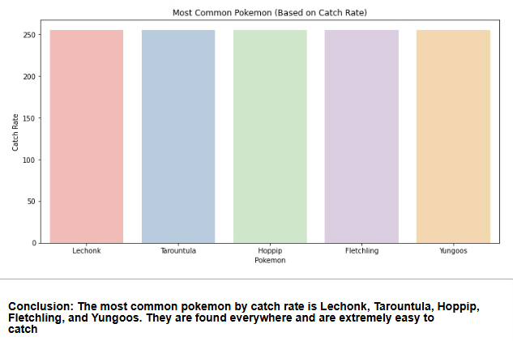
Results: 2. What are the most common Pokémon in Scarlet/Violet

Slide 10
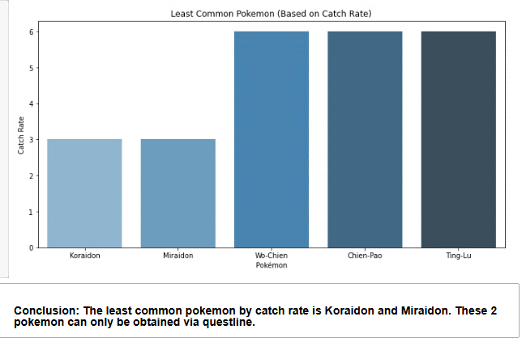
Results: 3. What are the least common Pokémon based on catch rate?

Slide 11
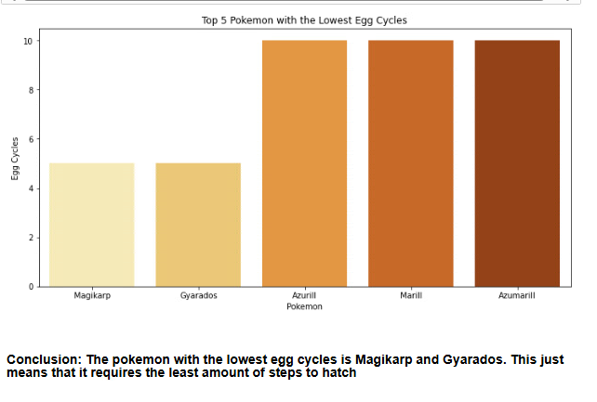
Results: 4. Which Pokémon have the lowest egg cycles in this Paldea?

Slide 12
Overall Conclusion
Players can use the low egg cycles of the Magikarp and Gyarados for breeding mechanics and speed up a lot of early game progression
Also using Slacking along with a version exclusive (Miraidon or Koraidon) would be very beneficial towards your party for progression

Slide 13
Future Work
I would want to continue to analyze the different types of Pokémon (strengths and weaknesses) and compare those along with the base stats to start helping out the competitive scenes.

